Slide 1

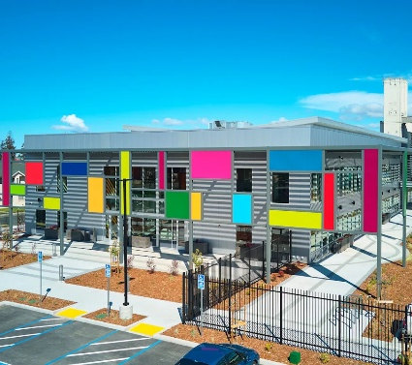

OAKLAND UNIFIED SCHOOL DISTRICT
Bond Program Update
March 2026
Notes:
https://www.ousd.org/select-a-school/elementary-school

Slide 2
BACKGROUND |
BONDS 101

Slide 3



BACKGROUND | BONDS 101
General Obligation Bonds
Bond repayment terms align with useful life of projects
Long-Term Financing Tool
General Obligation Bonds
  Voter approved long-term debt instruments
  Paid back by the legal obligation to levy and collect property taxes sufficient to pay annual debt service on the bonds
Bonds Repaid By Taxpayers Over 25-30 years
Bonds Issued
Tax rates are determined annually based on bond payments due and updated assessed values.
District uses bond proceeds for capital improvements*
* Proposition 39 bond proceeds can also be used to “furnish” and “equip” schools.

Slide 4
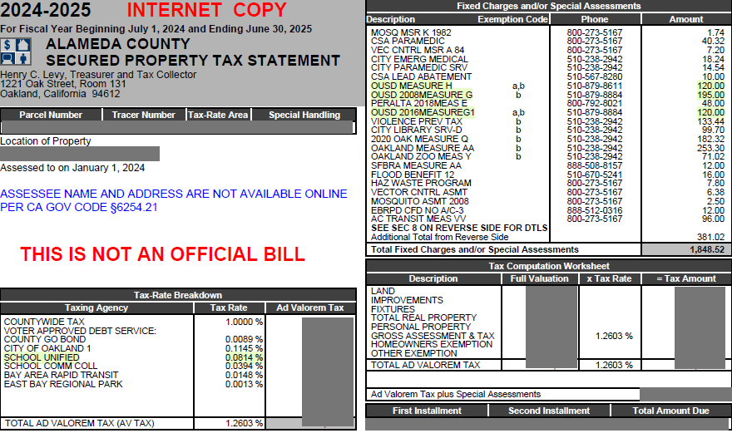
BACKGROUND | BONDS 101
Sample Tax Bill
Example from Tax Year 2024-25
District’s parcel taxes are listed in this section; actual payment amount does NOT depend on assessed value of the property.
District’s Bond program tax rates listed here; actual payment amount depends on the assessed value of the property.
Source: Alameda County

Slide 5
BACKGROUND | BONDS 101
Bond Authorizations
Oakland USD voters have passed five bond authorizations since 1994
Strong Voter Support
Date | Bond Authorization Size | Support | Final Maturity
November 8, 1994 (Measure C) | $170,000,000 | 84.0% (66.7% required) | 2024*
March 7, 2000 (Measure A) | $303,000,000 | 84.7% (66.7% required) | 2030
June 6, 2006 (Measure B) | $435,000,000 | 78.0% (55.0% required) | 2041
November 6, 2012 (Measure J) | $475,000,000 | 84.4% (55.0% required) | 2040
November 3, 2020 (Measure Y) | $735,000,000 | 77.7% (55.0% required) | 2048**
The District has $365 million in authorized but unissued bonds remaining from the 2020 Measure Y authorization
*The Series 2021 bonds included bonds from the 1994 and 2000 authorizations without a clear delineation; final maturity of the 1994 authorization is estimated to be 2024.
**May change based on repayment term of bonds remaining to be issued
Source: Smartvoter; Ballotpedia

Slide 6
BACKGROUND | BONDS 101
Community and Bonds
GO Bonds are community supported and it's important to incorporate community values into the bond program
Support | Review | Engagement
Independent Citizens Bond Oversight Committee
  Nine community members
  Ensures that bond proceeds are only spent for the specific projects listed in the bond measure
Successful Bond Measure
Implement Responsible Bond Program
Maintain and Garner Community Trust and Support

Slide 7
2026 BOND ISSUANCE

Slide 8
2026 GO Bond Issuance
Measure Y
Oakland USD voters passed Measure Y in November 2020 with 77.65% support
Strong Voter Support
Shall Oakland Unified School District’s measure to issue $735 million in bonds for classroom repair and school safety improvements including upgrading classrooms, science labs and technology; improving student safety and security; repairing bathrooms, electrical systems, and plumbing/sewers; and improving energy efficiency/earthquake safety; at legal rates, levying about $60 per $100,000 of assessed value, raising an average of $48.5 million annually for approximately 30 years, with citizens’ oversight, audits, and no money for administrator salaries be adopted?
Source: Smartvoter; Ballotpedia

Slide 9
2026 GO Bond Issuance
Measure Y
The Measure Y bonds were planned to be issued in four series issued approximately every other year
Issuance Schedule
Delivery Date | Series | Par Amount | Status
November 3, 2021 | Series 2021 | $185,000,000 | Issued
November 22, 2023 | Series 2023 | $185,000,000 | Issued
April 2026 | Series 2026 | $185,000,000 | In Progress
TBD | Series ”2028” | $180,000,000 | TBD
 |  | $735,000,000

Slide 10
2026 GO Bond Issuance
Measure Y
The Series 2026 Bonds will be the third series of bonds from the Measure Y authorization
Series 2026 Bonds
Bond Rate History and Projections
Responsible Structure
for Series 2026 Bonds
Par Amount | $185,000,000 (to meet project needs in the next two to three years)
Bond Structure | Traditional current interest bonds
Repayment Term | 25 years
  The Measure Y bond program was designed to manage the overall bond program tax burden on the community, particularly in the earlier years
  After the issuance of the Series 2025 Bonds, there will be $180 million in authorized but unissued bonds remaining from the 2020 Measure Y authorization

Slide 11
2026 GO Bond Issuance
Potential Refunding
Resolution tonight will add two additional series of bonds as refunding candidates
~$8.9 million in Projected Savings
Refunding Candidates
Series | Par Amount | Call Feature
2012 Series 2015 | $26,930,000 | Current
2015 Refunding | $51,195,000 | Current
2006 Series 2016 | $44,510,000 | August 1, 2026
2016 Refunding | $66,945,000 | August 1, 2026
Estimated
Refunding Statistics
Par Amount | $181,315,000
Gross Savings | $8,905,390
Present Value (PV) Savings | $7,159,146
PV Savings as % of Refunded Par Amount | 3.73%
Refunding Features
  Final Maturity = Does not extend the final repayment term
  Financing Costs = Estimated savings figures already accounts for any financing costs
  Combining with New Money = Issuing the refunding bonds with new money issuances reduces issuance costs
  Managing Bond Tax Rate = Helps to manage bond program tax rates
*Based on municipal bond market environment on March 3, 2026

Slide 12
2026 GO Bond Issuance
Issuance Schedule
Bond Issuance in May 2026
✓
Kick Off Financing
August 2025
✓
District Board 2x2s | District Board Approval
September 22 and 23, 2025 September 24, 2025
✓
Rating Presentation | Receive Rating
October 9th
✓
County Board Approval
November 18, 2025
District Board Approval of Updated Refunding Resolution and Latest Draft of Preliminary Official Statement (POS)
March 11, 2026
Post Preliminary Official Statement (POS)
March 18, 2026
Price Bonds
March 26, 2026
Closing
May 5, 2026 (To Be Finalized)

Slide 13
ADDITIONAL INFORMATION |
APPENDIX

Slide 14
Conflicts of Interest and Other Matters Requiring Disclosures
Pursuant to Municipal Securities Rulemaking Board (“MSRB”) Rule G-42, on Duties of Non-Solicitor Municipal Advisors, Municipal Advisors are required to make certain written disclosures to clients which include, amongst other things, Conflicts of Interest and any Legal or Disciplinary events of Isom Advisors, a Division of Urban Futures, Inc. (Isom Advisors) and its associated persons.
The following are potential conflicts of interest to be considered.
Isom Advisors represents that in connection with the issuance of municipal securities, Isom Advisors may receive compensation from an Issuer or Obligated Person for services rendered, which compensation is contingent upon the successful closing of a transaction and/or is based on the size of a transaction. Consistent with the requirements of MSRB Rule G-42, Isom Advisors hereby discloses, that such contingent and/or transactional compensation may present a potential conflict of interest regarding Isom Advisors' ability to provide unbiased advice to enter into such transaction. The contingent fee arrangement creates an incentive for Isom Advisors to recommend unnecessary financings or financings that are disadvantageous to the client, or to advise the client to increase the size of the issue. This potential conflict of interest will not impair Isom Advisors' ability to render unbiased and competent advice or to fulfill its fiduciary duty to the client.
Isom Advisors fees under this potential agreement may be based on hourly fees of Isom Advisors' personnel, with the aggregate amount equaling the number of hours worked by such personnel times an agreed-upon hourly billing rate. This form of compensation presents a potential conflict of interest because it could create an incentive for Isom Advisors to recommend alternatives that would result in more hours worked. This conflict of interest will not impair Isom Advisors' ability to render unbiased and competent advice or to fulfill its fiduciary duty to its clients.
Isom Advisors' fees under this potential agreement, may be a fixed amount established at the outset of the Agreement. The amount is usually based upon an analysis by the client and Isom Advisors of, among other things, the expected duration and complexity of the transaction and the Scope of Services to be performed by Isom Advisors. This form of compensation presents a potential conflict of interest because, if the transaction requires more work than originally contemplated, Isom Advisors may suffer a loss. Thus, Isom Advisors may recommend less time-consuming alternatives, or fail to do a thorough analysis of alternatives. This conflict of interest will not impair Isom Advisors' ability to render unbiased and competent advice or to fulfill its fiduciary duty to the client.
The fee paid to Isom Advisors increases the cost of investment to client. The increased cost occurs from compensating Isom Advisors for municipal advisory services provided.
Isom Advisors serves a wide variety of other clients that may from time to time have interests that could have a direct or indirect impact on the interests of another Isom Advisors client. For example, Isom Advisors serves as municipal advisor to other municipal advisory clients and, in such cases, owes a regulatory duty to such other clients. These other clients may, from time to time and depending on the specific circumstances, have competing interests. In acting in the interests of its various clients, Isom Advisors could potentially face a conflict of interest arising from these competing client interests. Isom Advisors fulfills its regulatory duty and mitigates such conflicts through dealing honestly and with the utmost good faith with its clients.
Isom Advisors does not have any affiliate that provides any advice, service, or product to or on behalf of the client that is directly or indirectly related to the municipal advisory activities to be performed by Isom Advisors;
Isom Advisors has not made any payments directly or indirectly to obtain or retain its clients municipal advisory business;
Isom Advisors has not received any payments from third parties to enlist Isom Advisors' recommendation to its clients of its services, any municipal securities transaction or any municipal finance product;
Isom Advisors has not engaged in any fee-splitting arrangements involving Isom Advisors and any provider of investments or services to its clients;
Isom Advisors does not have any legal or disciplinary event that is material to its clients evaluation of the municipal advisory or the integrity of its management or advisory personnel.
Isom Advisors does not act as principal in any of the transaction(s) related to this Agreement.
Randall Merritt, a Managing Principal, previously worked at Raymond James & Associates, Inc. from December 2015 until December 2023. Urban's relationships with Raymond James and all other investment banks are conducted in an arm's length manner, and any recommendations are independent of any prior employment or other relationships.
Legal Events and Disciplinary History
Isom Advisors does not have any legal events and disciplinary history on its Form MA and Form MA-I, which includes information about any criminal actions, regulatory actions, investigations, terminations, judgments, liens, civil judicial actions, customer complaints, arbitrations and civil litigation. The District may electronically access Isom Advisors' the most recent Form MA and each most recent Form MA-I filed with the Commission at the following website: www.sec.gov/edgar/searchedgar/companysearch.html.
There have been no material changes to a legal or disciplinary event disclosure on any Form MA or Form MA-I filed with the SEC.
13

