Slide 1

Regular Meeting of the
Community Advisory Committee
for Special Education (CAC)
February 12, 2024
https://ousd.zoom.us/j/87300141773
Meeting ID: 873 0014 1773 By Phone: 1-669-900-9128

Slide 2
If you are using
American Sign Language Interpretation,
you can go to video settings and click on
"hide non-video participants"
so that you can more clearly see the interpreter.

Slide 3

TODOS LOS CUERPOS SON ÚNICOS Y ESENCIALES.
TODOS LOS CUERPOS SON COMPLETOS. TODOS LOS CUERPOS
TIENEN FORTALEZAS Y NECESIDADES QUE SE DEBEN SUPLIR.
SOMOS PODEROSOS NO A PESAR DE LAS COMPLEJIDADES DE NUESTROS CUERPOS, SINO DEBIDO A ELLAS.
NOS MOVEMOS JUNTOS, SIN DEJAR NINGÚN CUERPO ATRÁS.
ESTO ES JUSTICIA DE DISCAPACIDAD.
https://www.sinsinvalid.org/

Slide 4
Security
Instructions

Slide 5
Please Use the
Sign-In Sheet

Slide 6
You can find links for tonight's documents at ousd.org/LCAP in the folder for the Community Advisory Committee for Special Education and under today’s date.

Slide 7
CAC Members and
Special Education/Central Office Administrators
Please remember to rename yourselves starting with the abbreviations
CAC or CEN
Example: CAC-Corvetta Kirtman

Slide 8
Who Is Helping Us Today!
Facilitator/Chair | Alan Pursell
Timekeeper | Melisha Linzie
Notetaker | Cintya Molina
Zoom Host | Raquel Jimenez
Chat Monitor | Lena Anthony
Link Monitor | Melisha Linzie
Thank you!

Slide 9
Meeting Goals
and Agreements

Slide 10
1) We will know:
→ How many paraprofessionals and instructional support specialists are assigned to students with IEPs, how those numbers are decided, and how well OUSD has been able to hire for these positions,
→ How many of these staff are staying in their positions year after year and what OUSD is doing to help them stay,
→ What other support positions exist within Special Education and how they are provided.
2) We will get answers to our questions about this information and offer suggestions for future action.
Notes:
https://www.huffpost.com/entry/what-to-call-disabled-person_l_5d02c521e4b0304a120c7549

Slide 11
Our Agreements
One person speaks at a time (one microphone)
Take space; make space
Honor the agenda
Tough on problems; easy on people
Listen to understand
Offer solutions

Slide 12
Review of the
Agenda

Slide 13
6:00 25 mins. | Welcome, Goals, Agreements, Introductions, Roll Call
6:25 15 mins. | Special Education Announcements
6:40 15 mins. | CAC Member Updates
6:55 10 mins. | Break
7:05 60 mins. | Presentation: Making Sure that Disabled Students with IEPs Have the Number of Paraprofessional and Instructional Support Specialists that They Need--Hiring and Retaining Special Education Support Staff in OUSD
8:05 10 mins. | Announcements, Appreciations, and Public Comments
Notes:
7:45
15 mins.
Community Resources for Students with Dis/abilities
Upcoming Engagements and Opportunities and How to Sign Up
How to Stay Informed about Resources for Students
Supporting Document: “Slides for the 3/14/22 Meeting of the Community Advisory Committee for Special Education”
8:00
20 mins.
CAC Member Updates
Meeting of the Outreach Subcommittee (Jonah Zimmerman-Bloch)
Recap of CAC Call to Protect Students with Disabilities by Rescinding School Closures; Opportunity to Support the Call by Speaking Out at the March 23 School Board Meeting; Change.Org Version of the CAC’s Call (Alan Pursell, Inga Wagar)
Next Steps for Implementation of Plan to Reduce the Grossly Disproportionate Suspensions of Black Students with Dis/abilities (Sayuri Valenza)
Implementation of Board Resolution No. 2021-0159, “Ensuring Access to Social-Emotional and Academic Supports for Students with Disabilities” (Patty Juergens)
Increasing Access for Young Adults at OUSD’s The Center (Kristen Zimmerman)
Supporting Documents: “CAC Call to Protect Students with Disabilities by Rescinding School Closures”, “Slides for the 3/14/22 Meeting of the Community Advisory Committee for Special Education”
8:20
10 mins.
Public Comments
8:30
Adjournment

Slide 14
Introducing
Ourselves

Slide 15
LEADERSHIP TEAM
All can be emailed at: firstname.lastname@ousd.org
Early Childhood Education (ECE) Director: Theresa Lozach
Elementary Director: Micaela Reinstein
Elementary Coordinators: Liana Nelson (Network 4) and Betty Lin (N3)
Middle School Director: Cary Kaufman
Secondary Coordinator: Bianca D'Allesandro [bianca.dallesandro@ousd.org]
High School Director: Stephen Raser
Young Adult Principal/Transition Director: David Cammarata
Related Services Director: Anne Zarnowiecki
SELPA Coordinator: Rain Johnson
Psychological & Mental Health Services Director: Stacey Lindsay

Slide 16

Now, everyone!
Please introduce yourself in the chat with your name and the name of your school, program, role, and/or organization.
You can also share the disability categories or identities with
which you are most familiar from personal or family experience.
Notes:
picture of two fists bumping with each other as a greeting
one fist is dark brown and one is light brown

Slide 17
Roll Call

Slide 18
Jonah Zimmerman-Bloch, Lateefa Ali, Lena Anthony
Jennifer Blake, Carol Delton, Ashley Demelo, Sheila Haynes, Ginale Harris, Patty Juergens, Corvetta Kirtman, Alan Pursell, Daisy López, Joe Manekin, Coriander Melious, Anna Realini, Tiffany Stewart, Sayuri Valenza, Inga Wagar,
JD Woloshyn, Kristen Zimmerman
20 members 5 open seats Quorum: 11
Members of the CAC for Special Education

Slide 19
Special
Education
Updates
15 minutes

Slide 20
Special
Events

Slide 21
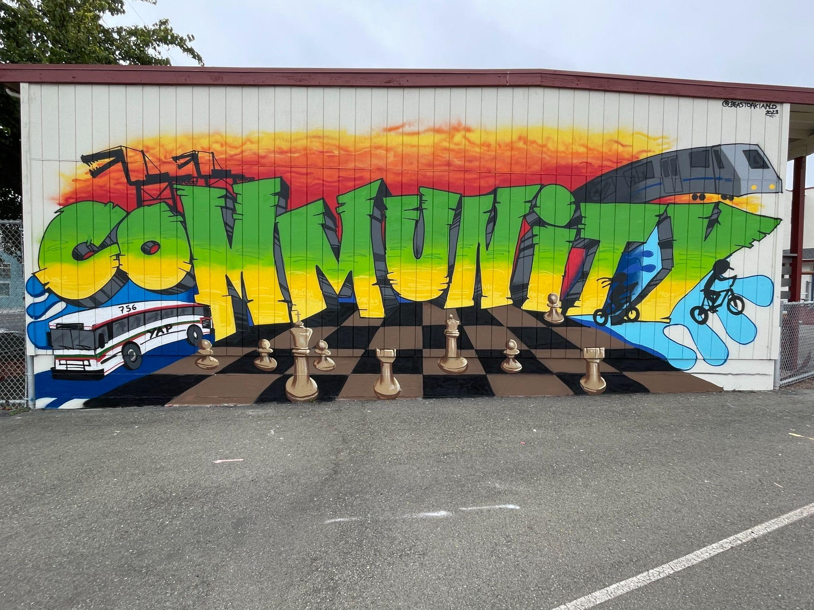


Social Media
Instagram
Name: @oaklanddiverselearners
Created: November 2023
Link: https://instagram.com/oaklanddiverselearners?utm_source=qr

Slide 22
Upcoming Events/Workshops
Wednesday, February 28, 2024, 5:30 - 6:30 PM
  Supporting your Child with Anxiety, 2.28.24 Anxiety.png - Zoom
Wednesday, March 27, 2024, 6-7PM
  Let's Talk...Expanding Food - Zoom
Newsletter December 2023
Family Workshop 2023-2024
Community Resources

Slide 23
CAC Member
Updates
6:35 pm 20 minutes

Slide 24
What We Do
  a) Advise the School Board, Superintendent, and other administrators of the Special Education Local Plan Area [OUSD] on the development, amendment, and review of the Local Plan for Special Education

Slide 25
What We Do
  b) Recommend annual priorities
  c) Assist in parent education and
  in recruiting parents and other volunteers who may contribute to the implementation of the plan

Slide 26
What We Do
  d) Encourage community involvement in the development and review of the local plan
  e) Support activities on behalf of individuals with exceptional needs

Slide 27
What We Do
  f) Assist in parent awareness of the importance of regular school attendance
  g) Support community involvement in the [LCAP] parent advisory committee . . . to encourage the inclusion of parents of individuals with exceptional needs

Slide 28
You can become a CAC member at any time.
If you are interested, contact Cintya Molina at 510-491-6069 or cintya.molina@ousd.org.
Nominees must attend a minimum of
3 CAC meetings to become CAC members.

Slide 29

For additional information about the CAC:
Link: tinyurl.com/ytwn3422

Slide 30
Updates on Actions
to Support our Initiatives

Slide 31
1) Board Adoption of Resolution to Promote School Stability and Belonging for Disabled Students in OUSD: Stopping the Expulsion of Disabled Students from their Schools to Close their Programs
2) Implementation of Plan to Reduce Suspensions for Disabled Black Students in Middle School Working Group meets every third Thursday. Next Meeting: Thursday, February 15 at 6pm.

Slide 32
3) Implementation of Board-Adopted Resolution No. 2021-0159 - Ensuring Access to Social-Emotional and Academic Supports for Students with Disabilities [After-School, Visual-Performing Arts, Athletics, Work-Based/Linked Learning, etc.]
4) Stable Programming and Space at The Center for Students in the Young Adult Program; Accessibility of Linked Learning and Work-Career Opportunities for Disabled Students We will provide an update for this initiative in March.

Slide 33
5) School Board Legislative Priorities Related to Special Education In January 2023, the School Board adopted the CAC's priorities within its larger Legislative Platform. For the full text as it reads in the platform, use the link on slide 34.
6) Sufficient Special Education Staffing for Disabled Students with IEPs: Special Education Teachers, Paraprofessionals, Instructional Support Specialists, etc. A working group of CAC members met with staff from the Talent Division on January 18th. They will meet every 3rd Thursday. This is the focus of tonight’s meeting.

Slide 34
To read about our initiatives in detail:
"2023-24 Initiatives of the OUSD Community Advisory Committee for Special Education"
tinyurl.com/2p8v7au3

Slide 35
Let Us Know If You Want to Help.
Write to us at cacoakland@gmail.com if you would like to support our committee or join a specific initiative.

Slide 36
CAC Key Dates and Events
W. 2/14 | CAC Report at the OUSD School Board Meeting | For Board agenda go to: www.ousd.org/board-of-ed/agendas-minutes-video
Th. 2/15 | Special Committee on Middle School Support for Black Students with Disabilities | 3rd Thursdays, 6:00 pm
Th. 2/15 | Working Group: Full & Sustainable Special Education Staff | 3rd Thursdays, 6:30 pm
W. 2/21 | CAC Report at the Meeting of the LCAP Parent & Student Advisory Committee (Focus on Options for Budget Reductions & Adjustments) | 3rd Wednedays. PSAC meeting begins at 5:30 pm. Zoom link at ousd.org/calendar
M. 2/26 | Planning Meeting | To suggest items for CAC discussion and action, write to cacoakland@gmail.com by 2/22

Slide 37
Share your feedback for the 2/28 School Board vote on reducing and adjusting the 2024-25 OUSD budget.
Attend the meeting in person. You can register to speak using a card at the meeting or ahead of time online. (Names are called in the order of registration.)
Write an e-comment or sign up to speak over Zoom up to one hour before the meeting begins. The e-comment and sign-up link is on the first page of the agenda. Once you click on the link, you will need to scroll to the agenda item about which you want to speak.

Slide 38
Lena Anthony, CAC Secretary
CAC Inbox News
cacoakland@gmail.com
Member Resources
A huge thank you to Grace Telcs for always keeping our Facebook page up to date! 🙏
facebook.com/CAC4SpEdOUSD

Slide 39

Break 10 minutes
https://www.youtube.com/watch?v=6Bn38mkJZNE

Slide 40
Posing the Questions; Naming the Problems
Notes from the CAC Dialogue with Staff from the Talent Division
1) Insufficient support staff is being allocated to students given the increase in the number of students who need support and the changing nature of their needs. This causes the remaining staff to burn out.
2) The pay for paraprofessionals and instructional support specialists is too low. They often take on other district jobs that pay more or other jobs altogether.

Slide 41
3) Is the fact that paraprofessionals and Instructional Support Specialists are not full-time contribute to them leaving the job? [They work .8 or 80% of a full-time position.]
4) What opportunities for advancement within their jobs do paraprofessionals and Instructional Support Specialists have?
5) How are the jobs of paraprofessionals and ISSs defined in nearby districts? How are they similar to the way they are defined in OUSD?

Slide 42
6) There seems to be a focus on recruiting Special Education teachers from the paraprofessional and ISS pool.
→ Is this increasing paraprofessional and ISS vacancies?
→ Are we recruiting other staff such as General Education teachers, reading intervention specialists, afterschool instructors, etc. to become Special Education teachers?
→ Do pipeline programs to recruit and retain paraprofessionals and Instructional Support Specialists exist?
7) What do we know about the stigma or prestige that this work carries for specific communities? What message are we sending about the value of the work that Special Education support staff do?

Slide 43
8) How do we combat the austerity mindset about Special Education investment, the false idea that we are “spending too much” on the education of disabled students?
We need better messaging about the value of this investment. We also need better messaging about the work being done to fill support staff and other Special Education positions.
9) How is staff assigned to recruit paraprofessionals and Instructional Support Specialists? How does this compare to what nearby districts are doing?

Slide 44
10) Are paraprofessionals and ISS positions being treated as "transitory? Are we presuming that people will quickly leave these positions? If so, what is the impact of this?
11 ) Is there a comprehensive a plan for quickly filling support staff vacancies as they arise? If so, how are we recruiting for them?
12) What policy changes within and outside OUSD do we need to ensure that students with IEPs have sufficient and consistent paraprofessional and ISS support throughout the school year?

Slide 45
Standards for Special Education Program Staffing
Primary factors that determine the number of staff:
→ Assessed student needs and services, as indicated in IEPs;
→ Collective Bargaining Agreements (CBAs) with the labor units that represent our Special Education personnel, where applicable;
→ California Education Code, where applicable
We also align to a statewide standard set by the Financial Crisis and Management Assistance Team (FCMAT).

Slide 46
Standards for Special Education Program Staffing
Resource Specialists serve students at a hard cap ratio of 1:27 (OEA CBA*). There is a “soft cap” of 22 for elementary and 25 for secondary, after which a plan of support must be provided.
Self-Contained Program teachers have caseloads** (OEA CBA):
Early Childhood Education (ECE) Mild-Moderate: 10
ECE Moderate-Extensive Support Needs: 8
School Aged Mild-Moderate: 13
School Aged Mental Health: 12 in 2024-25, 11 in 2025-26
School Aged Extensive Support Needs: 10
*OEA CBA: Oakland Education Association Collective Bargaining Agreement
**Caseload: The number of "cases" (clients, students, patients, etc.) that a professional has been assigned to support.

Slide 47
Standards for Special Education Program Staffing
3. Each self-contained program must be allocated at least one support staff position (OEA Collective Bargaining Agreement)
4. At least 80% of Resource Specialists must have support staff (California Education Code).

Slide 48
Standards for Special Education Staffing
OUSD supplements staffing in the following circumstances:
Extensive Support Needs Programs: two support staff as the base for the program.
This is to make sure there is enough support to attend to the basic physical care of students beyond their academic and functional skills goals;
Programs with more than three students who use wheelchairs.
This varies based on the number of students in the program with that level of need, as well as whether or not one or more students have dedicated staffing support already in place.

Slide 49
Staff Assigned to Each Program Type, ECE-5th Grade
These numbers do not include staffing to implement Intensive Individual or Behavior Intervention Services. Those staff follow the student with the need.
Program/Grade | # Teacher Positions | # Support Staff Positions
ECE Inclusive Services | 4 | 4
ECE MM Self-Contained | 13 | 13
ECE ESN Self-Contained | 16 | 30
K-5 Resource Specialists | 72 | 126
K-5 MM Self-Contained | 28 | 27
K-5 ESN Self-Contained | 34 | 71
K-5 Mental Health | 3 | 3

Slide 50
Staff Assigned to Each Program Type, 6th-Young Adult
Program/Grade | # Teacher Positions | # Support Staff Positions
6-12 Resource Specialists | 77 | 117
6-12 MM Self-Contained | 36 | 37
6-12 Mod-ESN Self-Contained | 29 | 68
6-12 Mental Health | 12 | 12
Young Adult | 12 | 35
Central Teachers (vacancy/leave coverage, interim placement teacher) | 4 | 0

Slide 51
Standards for Special Education Program Staffing
Additional staffing is assigned to programs with students who receive Intensive Individual Services (IIS) or Behavior Intervention Services (BIS) for the majority of their day.
Inclusive services may require additional staff beyond the base where the unique needs of the students in the teacher's caseload call for it.
This ensures that IEPs are implemented.

Slide 52


Slide 53
Can you show how paraprofessional and ISS numbers have kept apace with the number of students with IEPs? It would be good to see this starting in 2018-19 (for a pre-Covid baseline) up to the present. Can you show both allocations and actual hires?
Year | # of Staff (ISS/Para) | # of S w/ IEPs (CALPADS count)
2018-19 | 146 ISS positions @ .8FTE 347 para positions @ .8FTE | 6796
2019-20 | 160 ISS positions @ .8FTE 361 para positions @ .8FTE | 6801
2020-21 | 163 ISS positions @ .8FTE 382 para positions @ .8FTE | 6653*
2021-22 | 180 ISS positions @ .8FTE 392 para positions @ .8FTE | 7408
2022-23 | 168 ISS positions @ .8FTE 401 para positions @ .8FTE | 7418
*Note that very few initials were complete in 2020 because of COVID closures, impacting our counts.

Slide 54
We have had a net increase of 76 support staff positions over the last six years. During that time, we have increase eligible student counts by 622 students.
Many support staff additions have been assigned to self-contained programs that have opened during the last six years. 10 new ECE programs have required 16 more staff, for example. Further additions were necessary based on increases in Specialized Academic Instruction (SAI) services at particular school sites.
Note that there was a net decrease in support staff between 2021-22 and 2022-23
(-12 ISS and +9 Paraeducators)

Slide 55
How has the number of staff changed over time?
As the number of students who need self-contained, segregated programming has decreased, we have required more staff supporting services in general education classrooms.
Many Autistic students present with communication, behavior and executive functioning needs that impact access in different ways and that require additional support staff to implement IEPs.

Slide 56
How has the number of staff changed over time?
We have had an increase in the number of students who require dedicated Behavior Intervention Services to ensure implementation of Behavior Intervention Plans (BIPs) and maintain safety.
Additionally, we have seen increases in speech and language services as more students have presented with language-related needs that require speech as a related service.

Slide 57
Contracted Registered Behavior Technicians & Contracted Nursing Assistants/LVNs
Program/Grade | # Positions
Behavior Techs, Public School | 146
Behavior Techs, Nonpublic Schools or State Special Schools | 10
Licensed Vocational Nurse (LVN) or Certified Nursing Assistant (CNA)- Special Education Only | 13

Slide 58
Q: How has the increase in autistic students who need behavioral support throughout the day affected our allocation of support staff? Can you show how our allocation of support staff has changed as the number of students has increased?
A: Changes in staff have not been specific to students with Autism Spectrum Disorders only, though the high numbers of students eligible under AUT has impacted our ECE-5 grade band staffing more than any other disability category.
Over 55% of all students with IIS/BIS dedicated 1:1 staffing in their IEPs have Autism Spectrum Disorders.
In 2022-23, we added three FTE of Occupational Therapists in direct response to increasing sensory regulation needs for students with ASDs.

Slide 59
A: We have added base special education staff to the following campuses this year to ensure compliant implementation of SAI.
This has been largely, though not entirely, due to the increased incidence rates and needs of students with ASDs who are served in the general education environment.
Montclair
La Escuelita
Manzanita SEED
Thornhill
Joaquin Miller
Lincoln
ICS

Slide 61
Fill Rates
→ What success are we having in hiring for these positions? How quickly are those positions filled?
→ Where are positions filled most slowly?
Slides 77 to 79 include data up to school year 2022-23. Staff will also provide highlights from 2023-24.

Slide 62
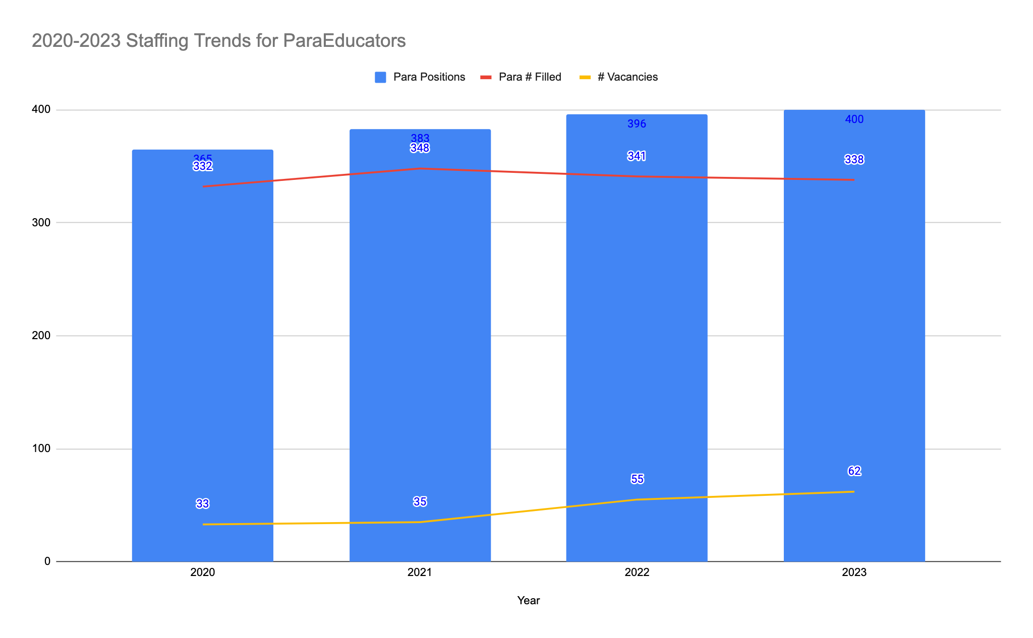
Title
Details
Notes:
As of 3-2 for each year

Slide 63
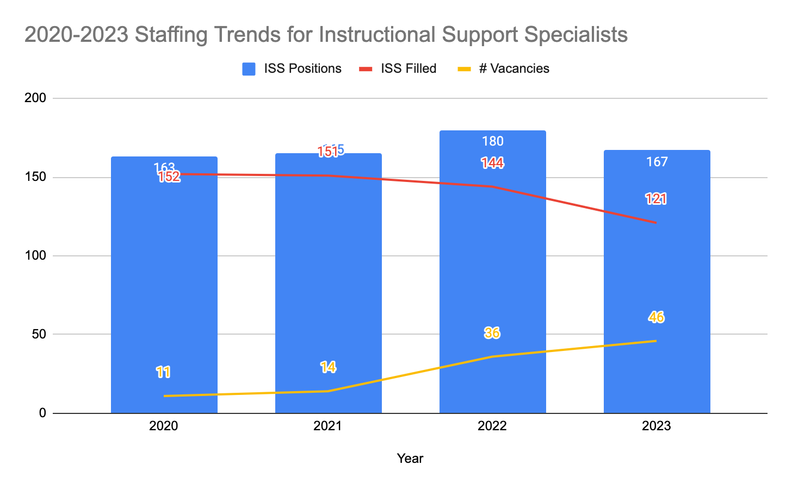
Notes:
in 22-23, the minimum qualifications to become a substitute teacher shifted, and the pay substantially increased to first year teacher wages. The minimum qualifications to become a substitute teacher also decreased to BA only, which opened up an opportunity for our instructional support specialists to earn more.

Slide 64
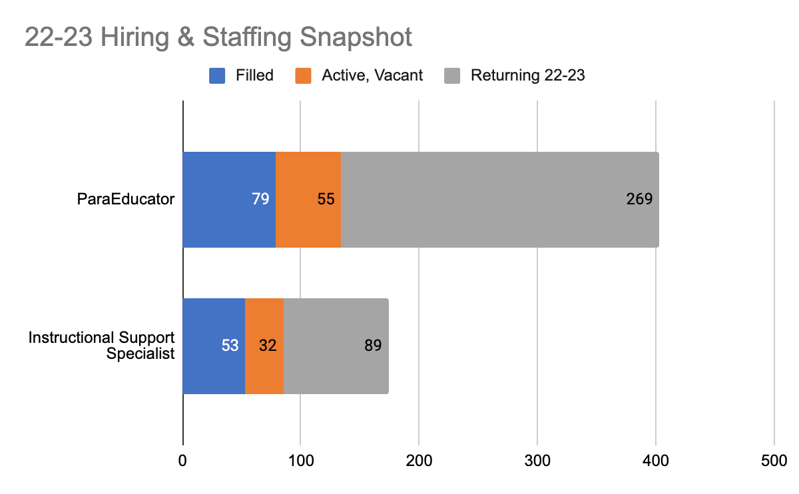

Slide 66
Persistent Vacancies
→ How many of these positions remain unfilled? Where?
→ How long have these vacancies persisted?
→ Where do vacancies fluctuate the most, with staff frequently leaving positions after being hired?
→ Why do they leave the position? What is the feedback from staff?

Slide 67
Persistent Vacancies (School Year 2023-24)
We have had persistent vacancies or high attrition* of support staff (paras and ISSs) at specific school communities this year:
Montera Middle
Skyline High
Coliseum College Prep Academy
Redwood Heights
Edna Brewer
MetWest
*attrition: the rate at which employees leave a workforce (how quickly)

Slide 68
Persistent Vacancies (School Year 2022-23)
We have had persistent vacancies or high attrition* of support staff (paras and ISSs) at specific school communities over the last several years, including:
Montera Middle
Castlemont High
Skyline High
Coliseum College Prep Academy
Korematsu Discovery Academy
*attrition: the rate at which employees leave a workforce (how quickly)

Slide 70
Retention Rates
→ What are the one-year and three-year retention rates for paraprofessionals and instructional support specialists?
→ What is the average retention rate for these positions? Where are retention rates the highest? Where are they the lowest?
→ Is data gathered to find out why staff in these positions leave or remain in them?
Slides 84 to 90 include data up to school year 2022-23.
Staff will also provide highlights from 2023-24.

Slide 71
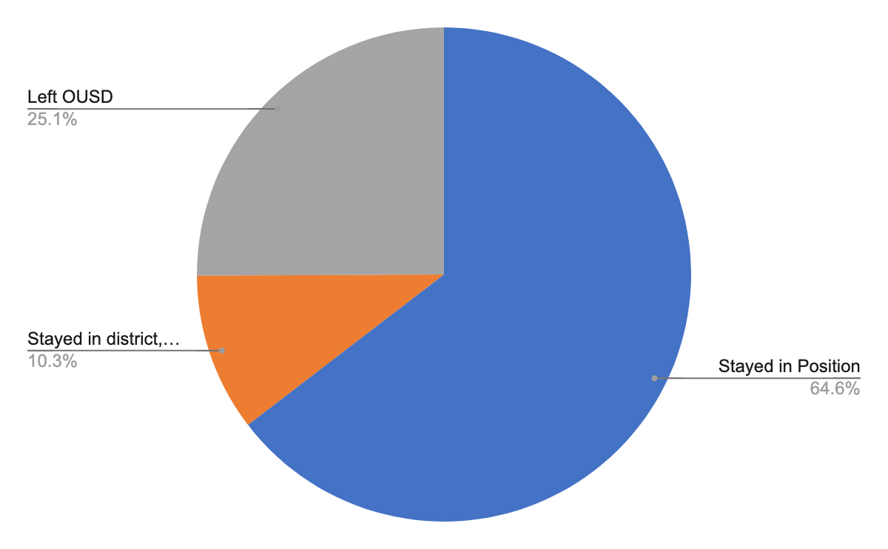
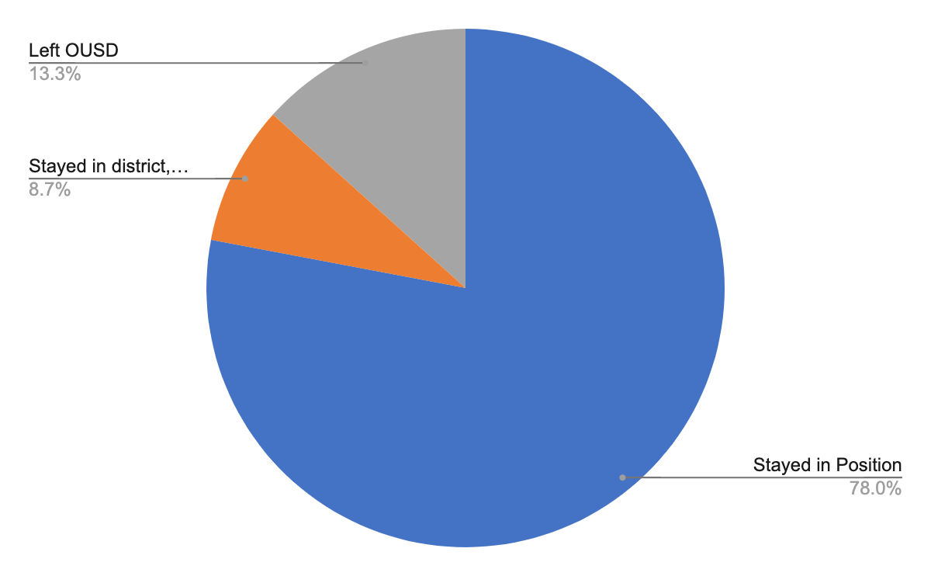
One-, Three- year retention rates for ParaEducators
One year Para retention
Three year Para retention

Slide 72
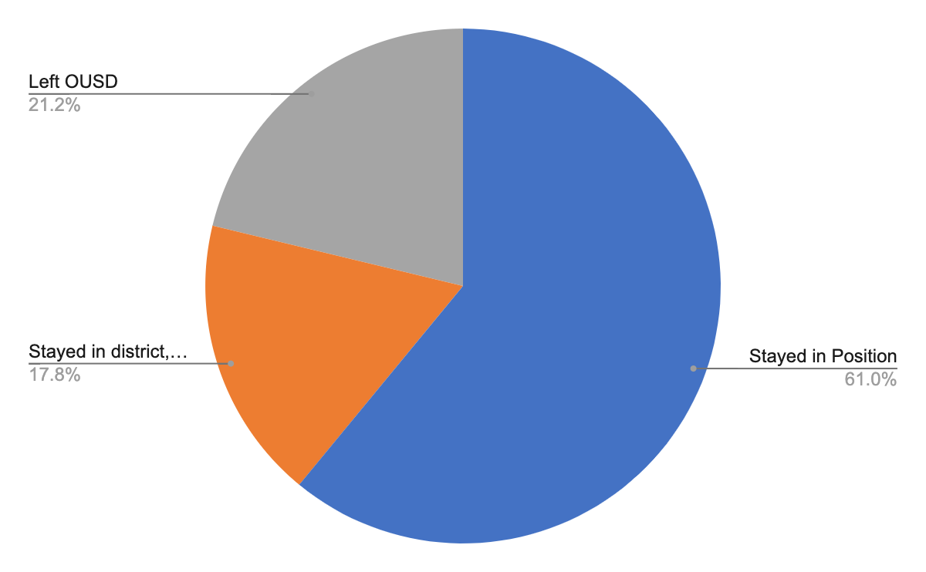
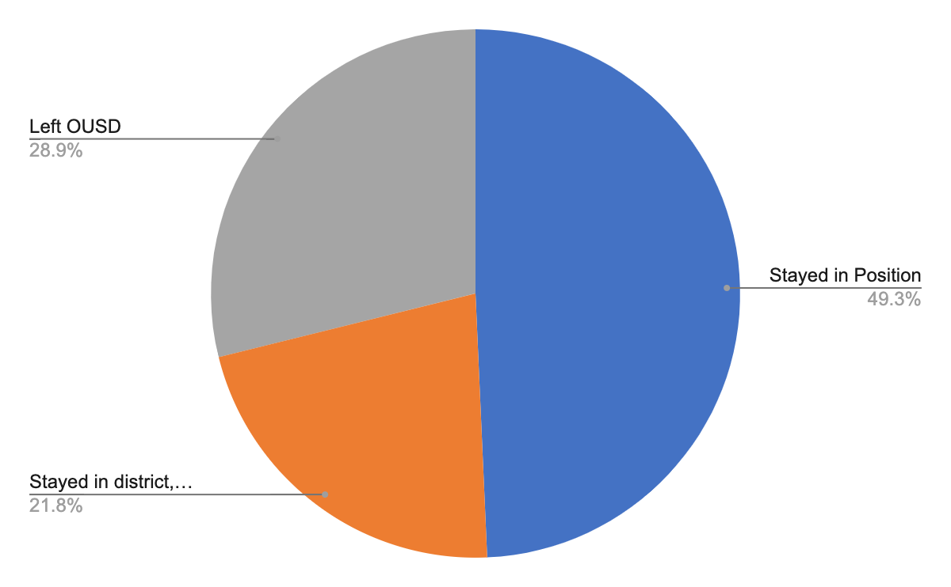
One-, Three- year retention rates for ISSs
One year ISS retention
Three year ISS retention

Slide 73
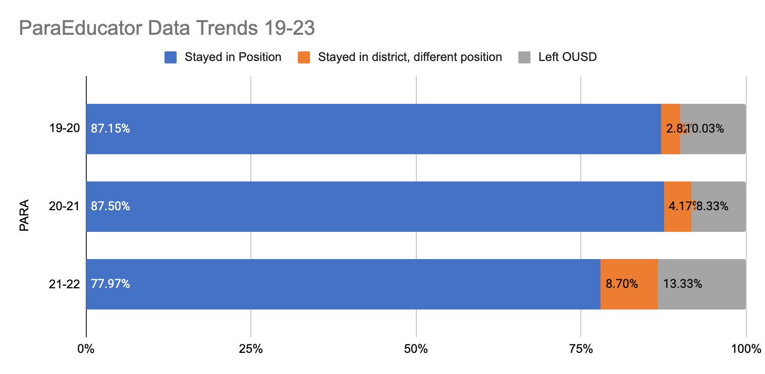
Data at a Glance - Para-Educators

Slide 74
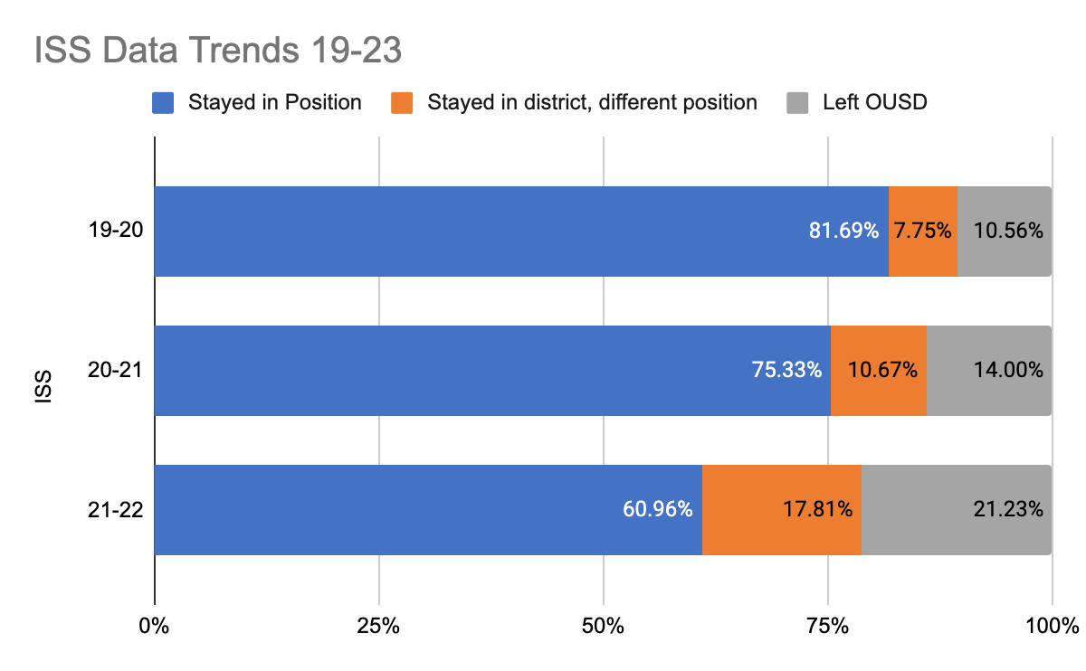

Slide 75
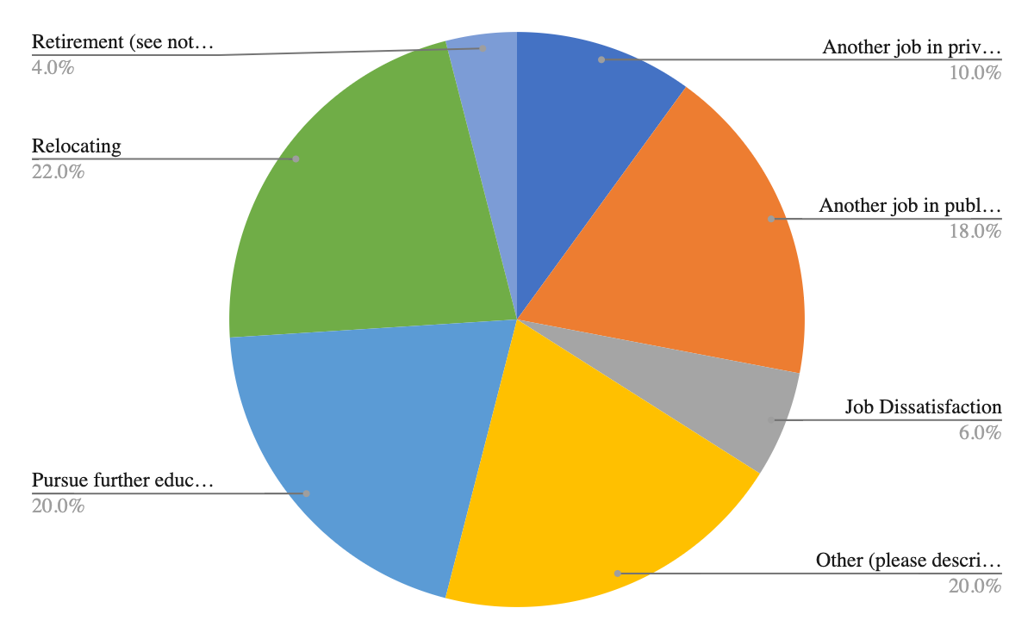
Reasons ParaEducators State for Leaving, 20-23
***

Slide 76
Para comments about leaving
Counseling Enriched Classroom Teacher
Due to mother's medical illness, I must step up as her full time caretaker.
Going to graduate school and becoming a student teacher
I am going to graduate school to receive my teaching credential and Master's of Education.
I feel that the social and emotional weight that comes with the position will compromise my ability to study for my board exams.
I was hired at Alameda County Probation Department.
MEDICAL REASONS
Medical reasons
Preparing for first year teaching: shadowing, curriculum, lessons, etc.
relocation to care for elderly parents
SFUSD SPED INTERN TEACHER
Starting Graduate School

Slide 77
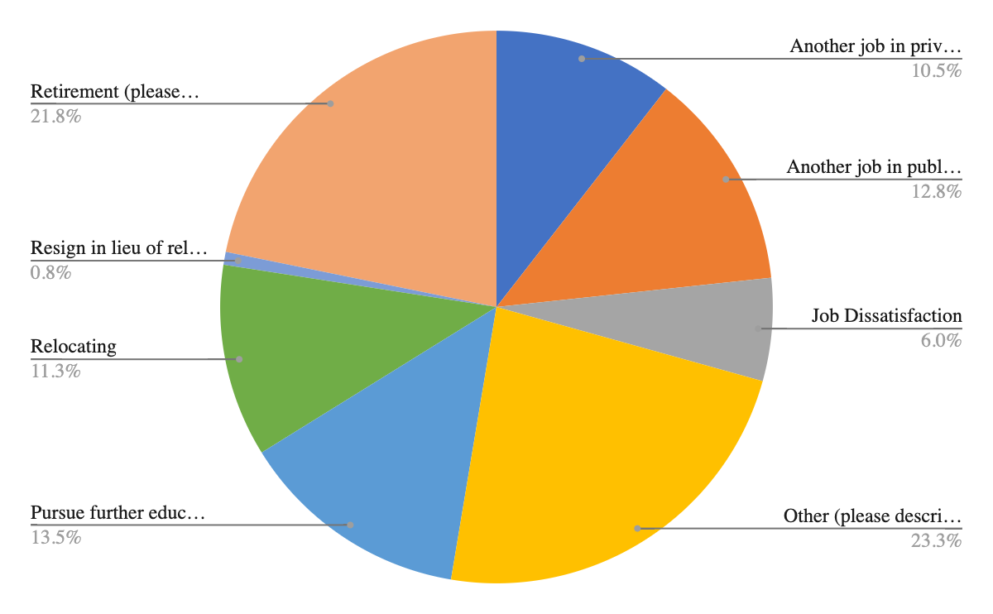
Reasons Instructional Support Specialists Leave, 20-23
***

Slide 78
ISS Comments about Leaving
Did not feel that I was being appreciated for the amount of work and investment I was putting into the school and youth I was working with
Father is terminally ill, Leaving my position to spend as much time as I can with him.
I am retiring from OUSD and moving out of the state
I have a different employment opportunity.
I have a medical condition seizures which is occurring very frequently.
I was offered a position through Lincoln Families under their HOPE Mental Health Program services as an Intervention Specialist and will continue to work on site at Oakland Academy of Knowledge through them.
I will be starting a graduate program at CSUEB and need to switch to a position with fewer hours.
I’m going back to school
Lack of transparency during hire and interview.
Lack of transparency during interview
Medical condition seizures
Moving to a different State.
Must return to part time work.
need to take care of my 1 year old baby
No longer able to perform the duties due to a car accident
Pursuing a job in another field besides education
Recently I’ve been working 2 jobs to make ends meet and it’s taken a toll on me mentally and physically and I was able to find a job that will put these 2 jobs together so I only have to work 1.

Slide 79
Potential Candidate Experience for Para Educators
Starting pay for the position is about 17.22 an hour. Candidates have expressed that they are unable to support their own needs.
Time Commitment for the prerequisite process.
  Fingerprinting/Live Scan process
  CPR/First Aid Training (up to 3 hours in-person/online)
  ParaPro exam - no fail rate (2 hours / test attempt)
15 hours of additional training to perform other duties of the job
The complete time frame can range from 1-2 weeks depending on availability - other opportunities might arise during this time.

Slide 80
Potential Candidate Experience for Instructional Support Specialists:
Starting pay for the position is about 21.72 an hour. Candidates have expressed that they are unable to support their own needs.
Candidates need 30 hours of Applied Behavioral Analysis (ABA) training.
Time Commitment for the prerequisites process.
  Fingerprinting/Live Scan process
  CPR/First Aid Training (up to 3 hours in-person/online)
  Proof of completion of Bachelor's degree (transcripts)

Slide 81
Potential Candidate Experience for Instructional Support Specialists:
Additional training to perform other duties of the job - willing to obtain Crisis Prevention Intervention certification
This complete time frame can range from 1-2 weeks depending on availability - other opportunities may arise during this time
STIP Sub: Site-Based Sub Teacher - 284.44/day (same minimum requirements)

Slide 83
Announcements, Appreciations Comments

Slide 84

TODOS LOS CUERPOS ESTAN ATRAPADOS EN LAS ATADURAS DE LA CAPACIDAD, RAZA, CLASE, GENERO, SEXUALIDAD Y CIUDADANIA.
SOMOS PODEROSOS NO A PESAR DE LAS COMPLEJIDADES DE NUESTRAS IDENTIDADES, SINO DEBIDO A ELLAS.
SÓLO EL ACCESO UNIVERSAL Y COLECTIVO NOS PUEDE LLEVAR A LA LIBERACIÓN UNIVERSAL Y COLECTIVA.
ESTO ES JUSTICIA DE DISCAPACIDAD.
https://www.sinsinvalid.org/

